Slide 1

Smart Campus Early-Warning & Decision Support System
Team Members: Kavyalakshmi | Baby Jyostna | Charan | Tharun

Slide 2
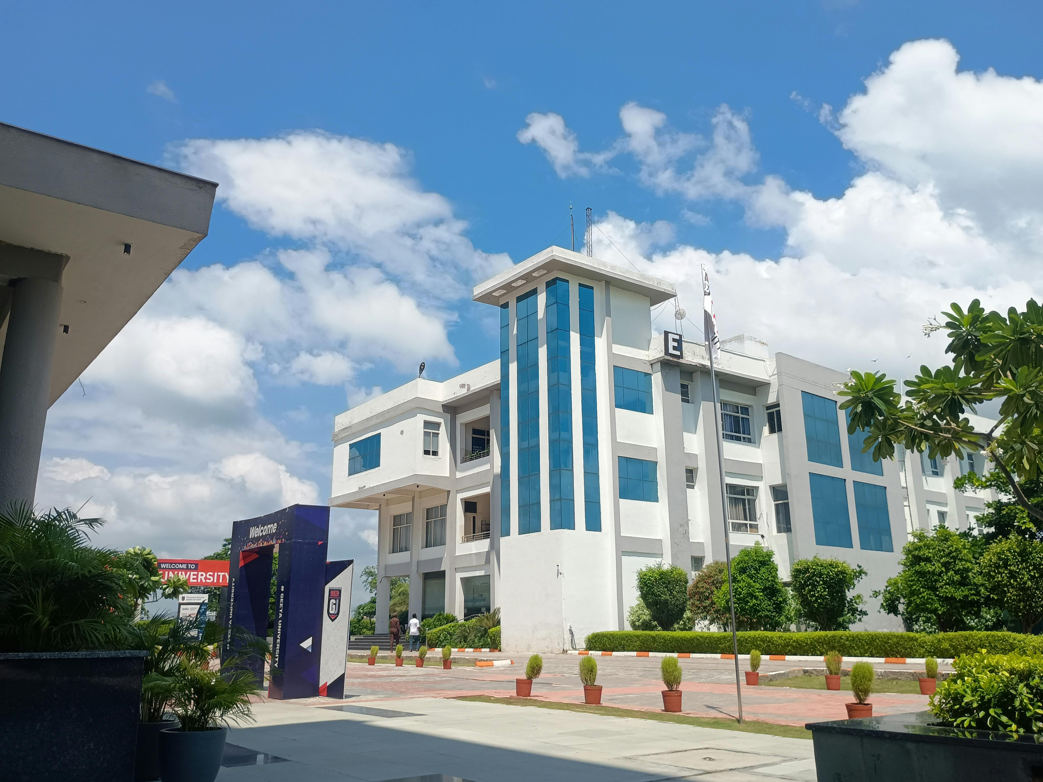
Problem Statement
What is the Problem?
Campus conditions change continuously.
Problems may not be identified.
Manual monitoring of multiple conditions is difficult.
Student, campus, and environmental data are often considered separately.
Management needs quick and data-driven decisions.

Slide 3
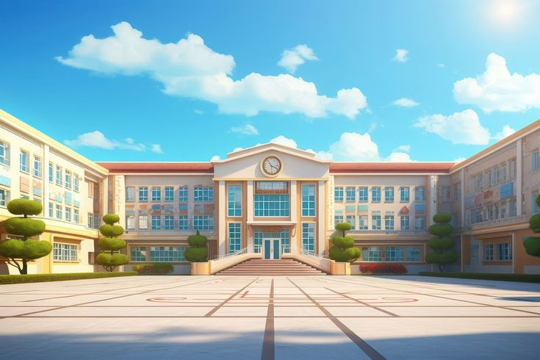

Objective
The main objective of this project is to monitor different campus conditions and identifies potential risks related to students, campus facilities, and the environment. The system uses campus data and Machine Learning to predict the risk level and provide an early warning along with a recommended preventive action.

Slide 4


Main Features:
Risk Prediction – Analyze the input data using a Machine Learning model.
Risk Classification – Classify the situation into:
1.Low Risk
2.Medium Risk
3.High Risk
Early Warning – Generate a warning when a potential problem is detected.
Recommended Action – Suggest preventive action for the detected risk.
Simple Dashboard – Display input values, risk level, warning, and recommendation clearly.
Real-Time Analysis – Analyze the values entered by the user and immediately show the prediction.

Slide 5



Libraries Required:
Pandas
NumPy
Scikit-learn
Plotly
Joblib
Streamlit

Slide 6

What Data Do We Monitor?
Student Conditions
Campus Conditions
Occupancy
Electricity usage
Internet usage
Maintenance complaints
Attendance
GPA
Assignment completion
Backlogs
Environmental Conditions
Click Here
Temperature
Humidity
Rainfall
Water level
Air Quality Index

Slide 7


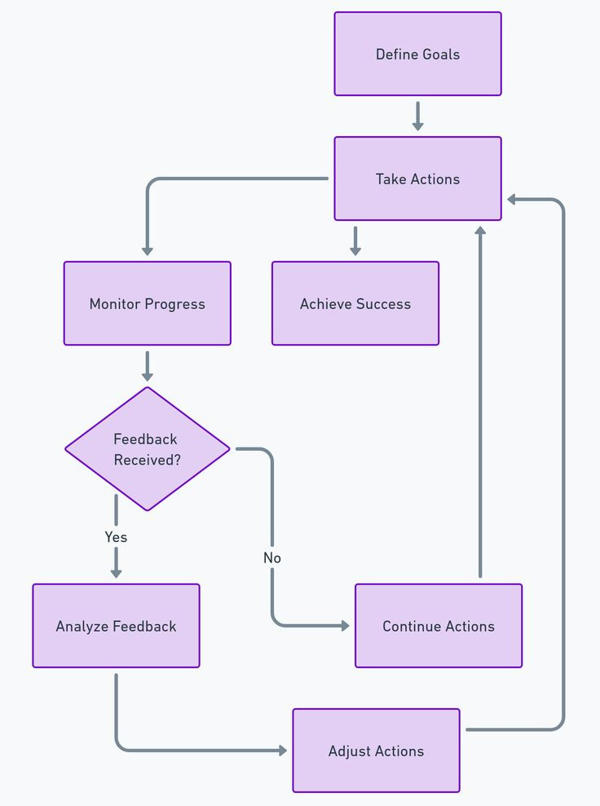
Processing Flow
Campus Data Input
⬇
Data Preprocessing
⬇
Machine Learning Model
Risk Prediction
⬇
Risk Classification
⬇
Early Warning Generation
⬇
Recommended Action
⬇
Dashboard Output

Slide 8
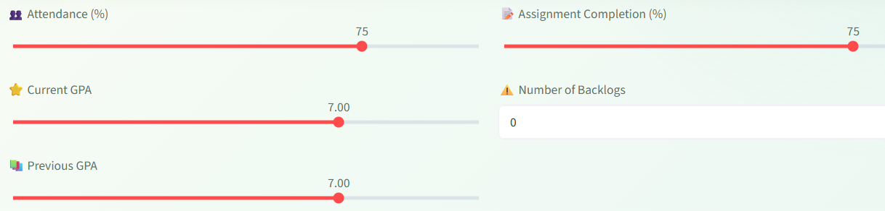
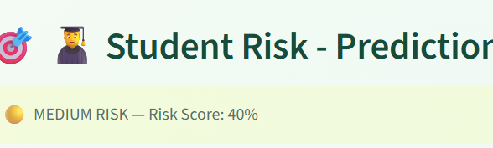
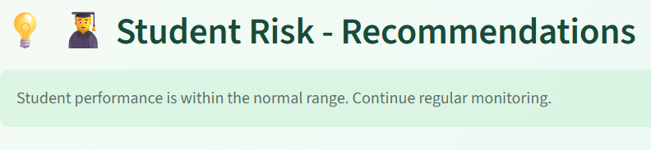
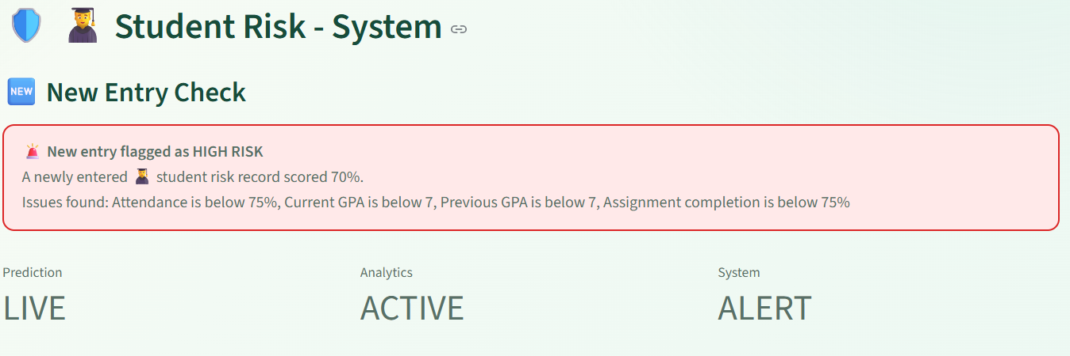
Smart Campus Dashboard
⬇
⬇
⬇
The dashboard allows users to enter campus conditions, predict the risk level using the trained ML model, and view the resulting warning and recommended action in a clear and simple interface.

Slide 9


💡 Benefits
Early identification of potential risks.
Data-driven decision-making.
Helps management prioritize interventions.
Combines student, campus, and environmental information.
Provides visual insights through charts.
Can be extended to real-time campus monitoring.

Slide 10


Final Goal
The main goal of this project is to help campus management identify potential problems before they become serious. Instead of waiting for an incident to occur, the system analyzes campus data, predicts the risk level, generates an early warning, and recommends preventive action.

Slide 11

Future Scope
📡 IoT sensor integration
🌦️ Real-time environmental data
📱 Mobile application
🔔 Automated alerts
📧 Email/SMS notifications
📊 Advanced analytics
🏫 Integration with campus management systems
In the future, our Smart Campus system can be enhanced with real-time monitoring, IoT sensors, automated alerts, mobile applications, and additional data sources to make risk detection faster, smarter, and more effective.

Slide 12
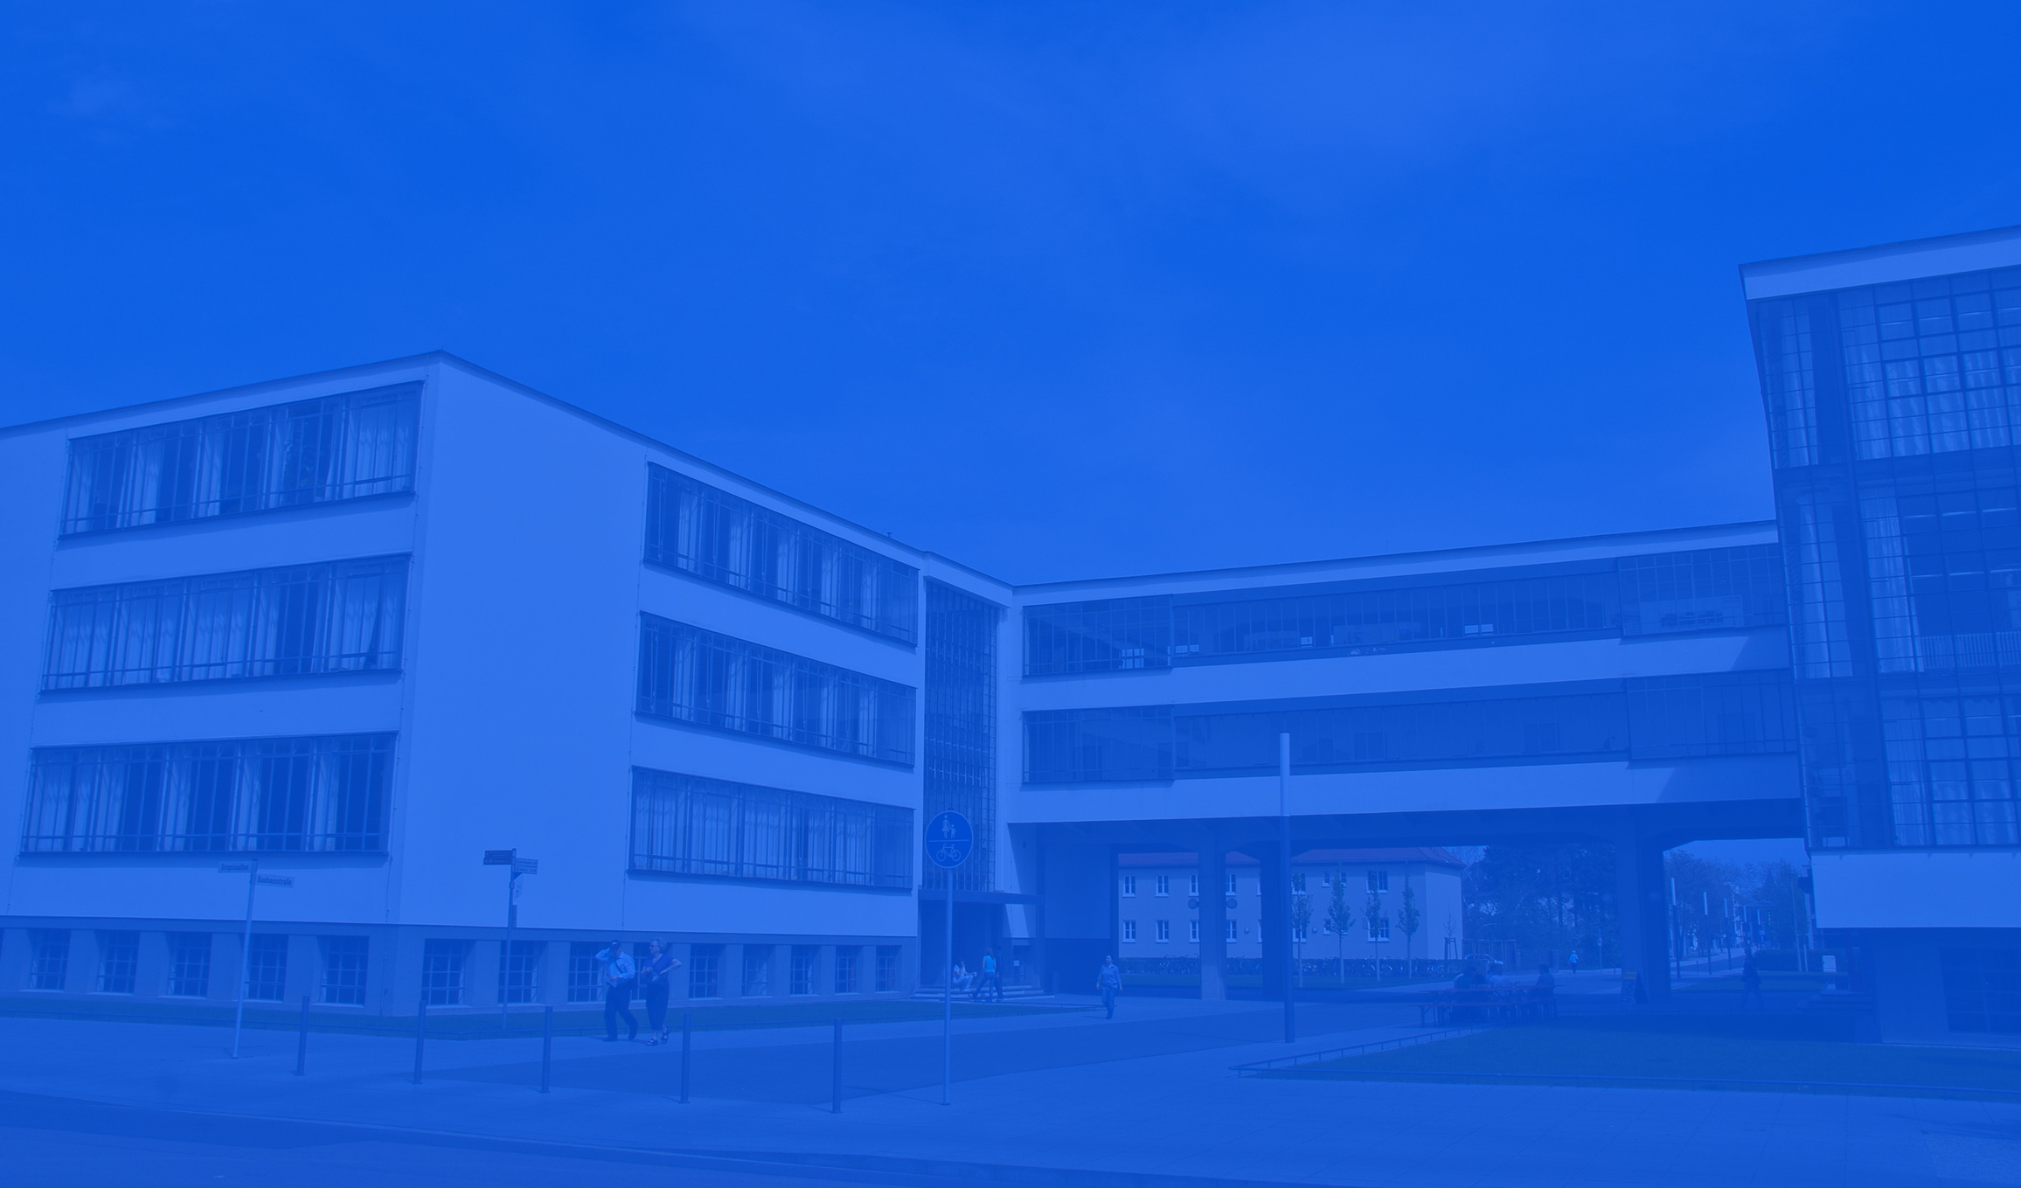
Thank You

